Slide 1
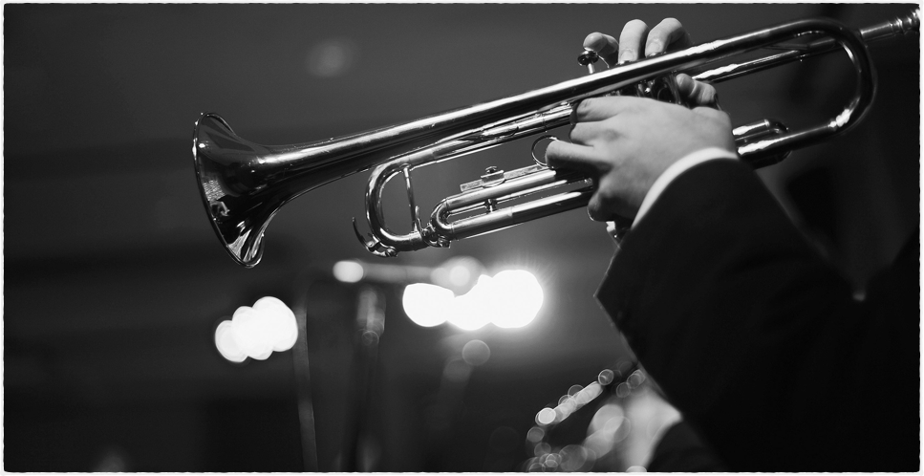
Movies & Music App
A Streamlined App For Movie Lovers

Slide 2
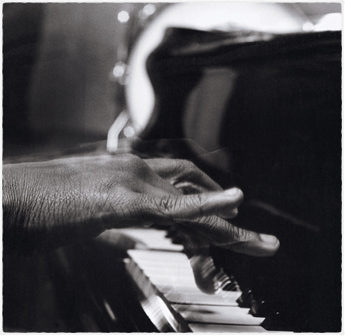
Description
Welcome to the Big Screen!
Are you a movie lover?
Ever wonder about the music from your favorite movie.
Our program is effortless and magical when comes to pairing your favorite movie with its music.

Slide 3
Motivation
Our motivation is to “digitally detox” from the use of multiple sources to get music for our favorite movies.

Slide 4
“We are a one stop shop that solves that problem. Search for your favorite movie and the music shows up automatically.”
–The Matrix Team - Project 1

Slide 5
Team Efforts
We placed all of the tasks for the creation of our app in our Projects GitHub Repository and we all helped where we were able.

Slide 6

Individual Efforts (Primary Efforts)
Ben & Eric - Front End, CSS, HTML, Materialize, Conceptualization of App & Movie API Search.
Kevin and Will- JavaScript, iTunes Api, Firebase,
The Movie Database API, OMDB API, & App. data
architecture.

Slide 7
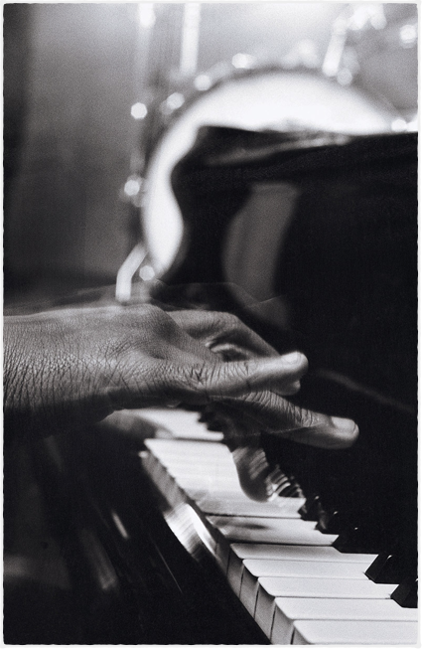
Challenges
In Making
Our App.
Find API’s that functioned with our overall concept.
Finding a suitable frontend display to make our APP visually appealing.

Slide 8
Possible Improvements
Linking of more external resources within the app i.e. (additional information within the app)
Adding movie trailers

